Slide 1
Health
Notes:
Warrior Creed

Slide 2
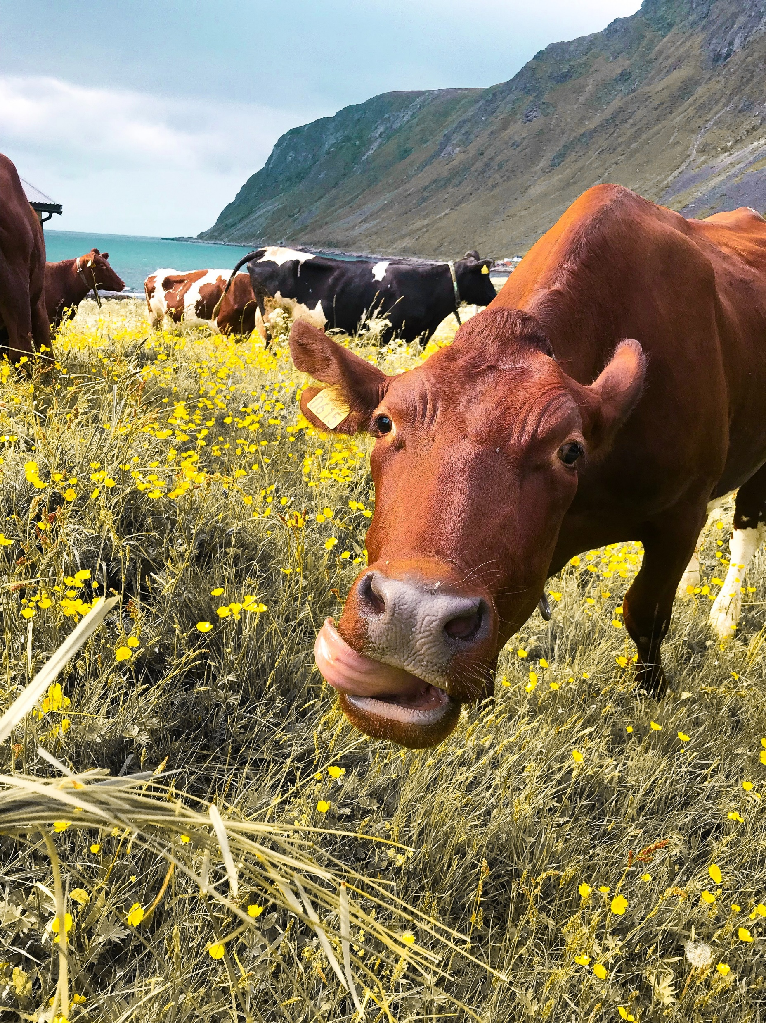
Diet
You are what you ate, ate?
Notes:
Best example of this is Goggins Accountability Mirror.
Its all about making sure the real you is the reflection

Slide 3
Diet Schedule
Everyday
Determine a continuous 8 hour feed window.
Only eat during that window
Determine your 16 hour fasting window
Recommend Schedule 19:00 hrs through 10:00 hrs next day.
Notes:
Lombardi
What do you stand for…from a business perspective.
How are you known?

Slide 4
Meal Plan
Eat whatever your want
Only 1 Rule – only eat during the feed window

Slide 5
Everyday Regime
Perform workout the same time every day
Duration 7 min 30 sec
Hold child pose
Perform 10 push-ups
Hold Plank for 30 seconds
Perform 25 Air Squats
Hold child pose
2 minutes
1 minute
1 minute
1 minute 30 sec
2 minutes

Slide 6
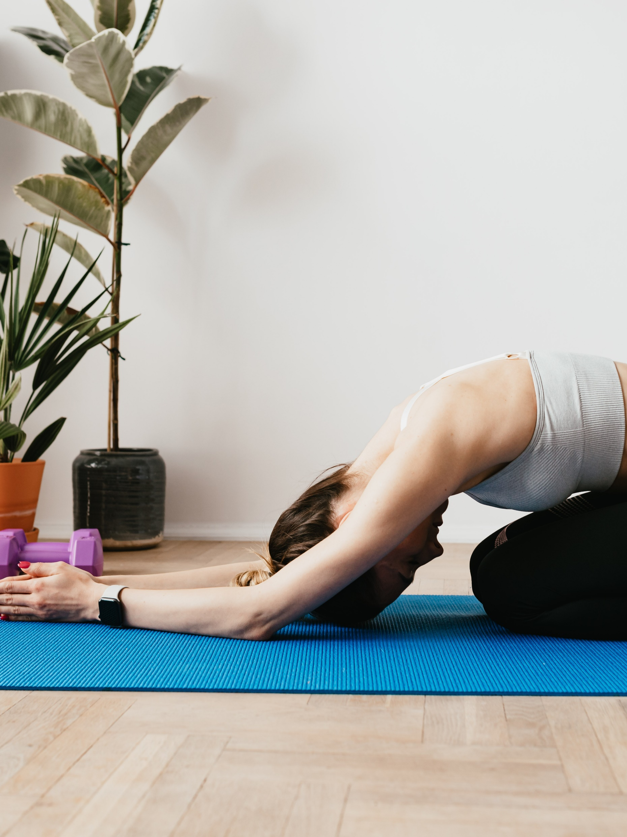
Yoga – Child Pose
Hold pose for 2 minutes

Slide 7

Core Strength – Push-Ups
Perform 10 reps

Slide 8

Core Strength – Plank
Hold plank position for 30 seconds

Slide 9

Leg Strength – Air Squat
Perform 25 reps

Slide 10
Yoga – Child Pose
Hold pose for 2 minutes

Slide 11
End Health
Notes:
Warrior Creed

